Slide 1
Why a Python Programmer Should Learn C (yes really)
Charles Severance (a.k.a. Dr. Chuck)
University of Michigan School of Information

Slide 2
Note that I did not say "Write C"
(unless you are or want to be a core CPython dev)

Slide 3
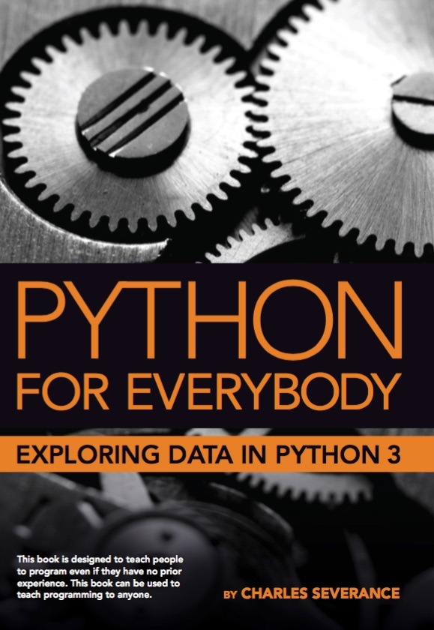
Coursera: Python for Everybody
Introduced in 2013, Updated 2016, 2024
The most popular programming course in the world
>3M graduates (>1M in India alone)
Translated into 10+ Languages
In browser development environment
Many auto-graded exercises
Extra – more than just a course
Interviews
Office Hours

Slide 4
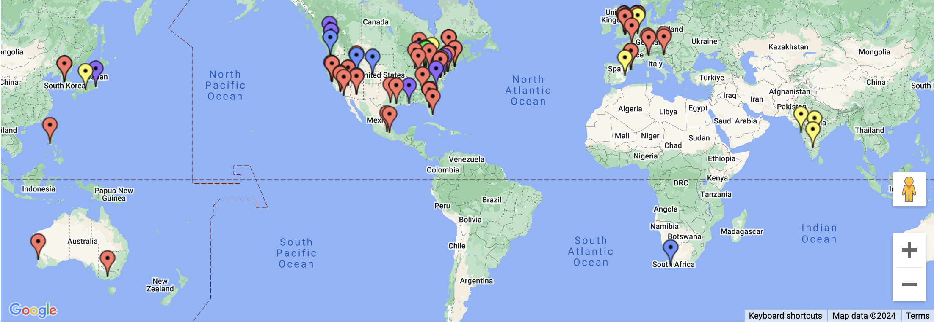
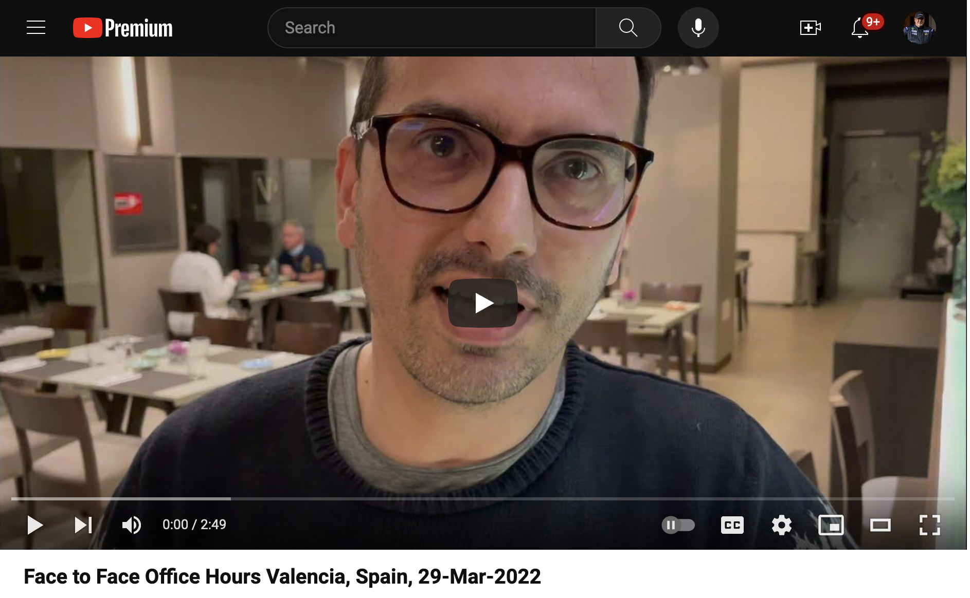

Slide 5
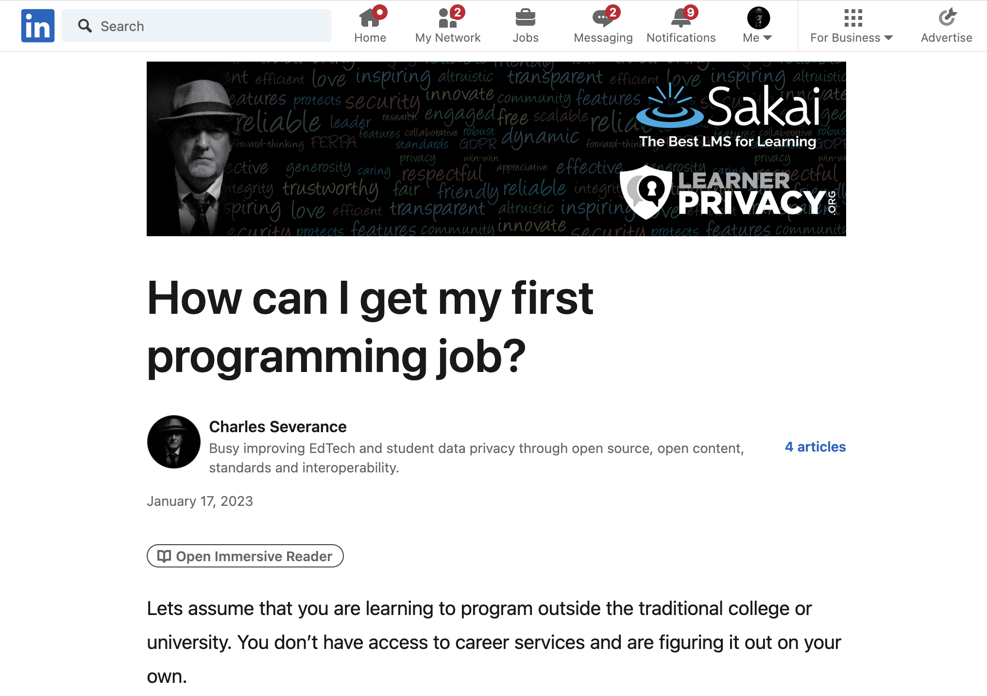

Slide 6

Introductory Programming
Ready to Work

Slide 7

Who would I hire?
I have met many amazing developers
Not the most educated
Not the most brilliant minds
Learned through working on large complex projects
Love to help other people learn

Slide 8
It is not what they know…
Flask
SpringMVC
RedShift
BigData
Rust
Java
C#
Scala
JavaScript
HTML
Go
C++
VB
Fortran
AI
Kotlin
Node
PHP
C
React
JQuery
Perl
Dart
Backbone
Angular
R
ObjectiveC
Svelte
Lua
Ruby
COBOL
Django
SQL
Assembly
Swift
Python
Jupyter

Slide 9

It is how they learn
Can learn any programming situation and master it in four weeks
See past the syntax (X-ray Vision)
Run-time environments and internal data structures memory use, performance tradeoff

Slide 10
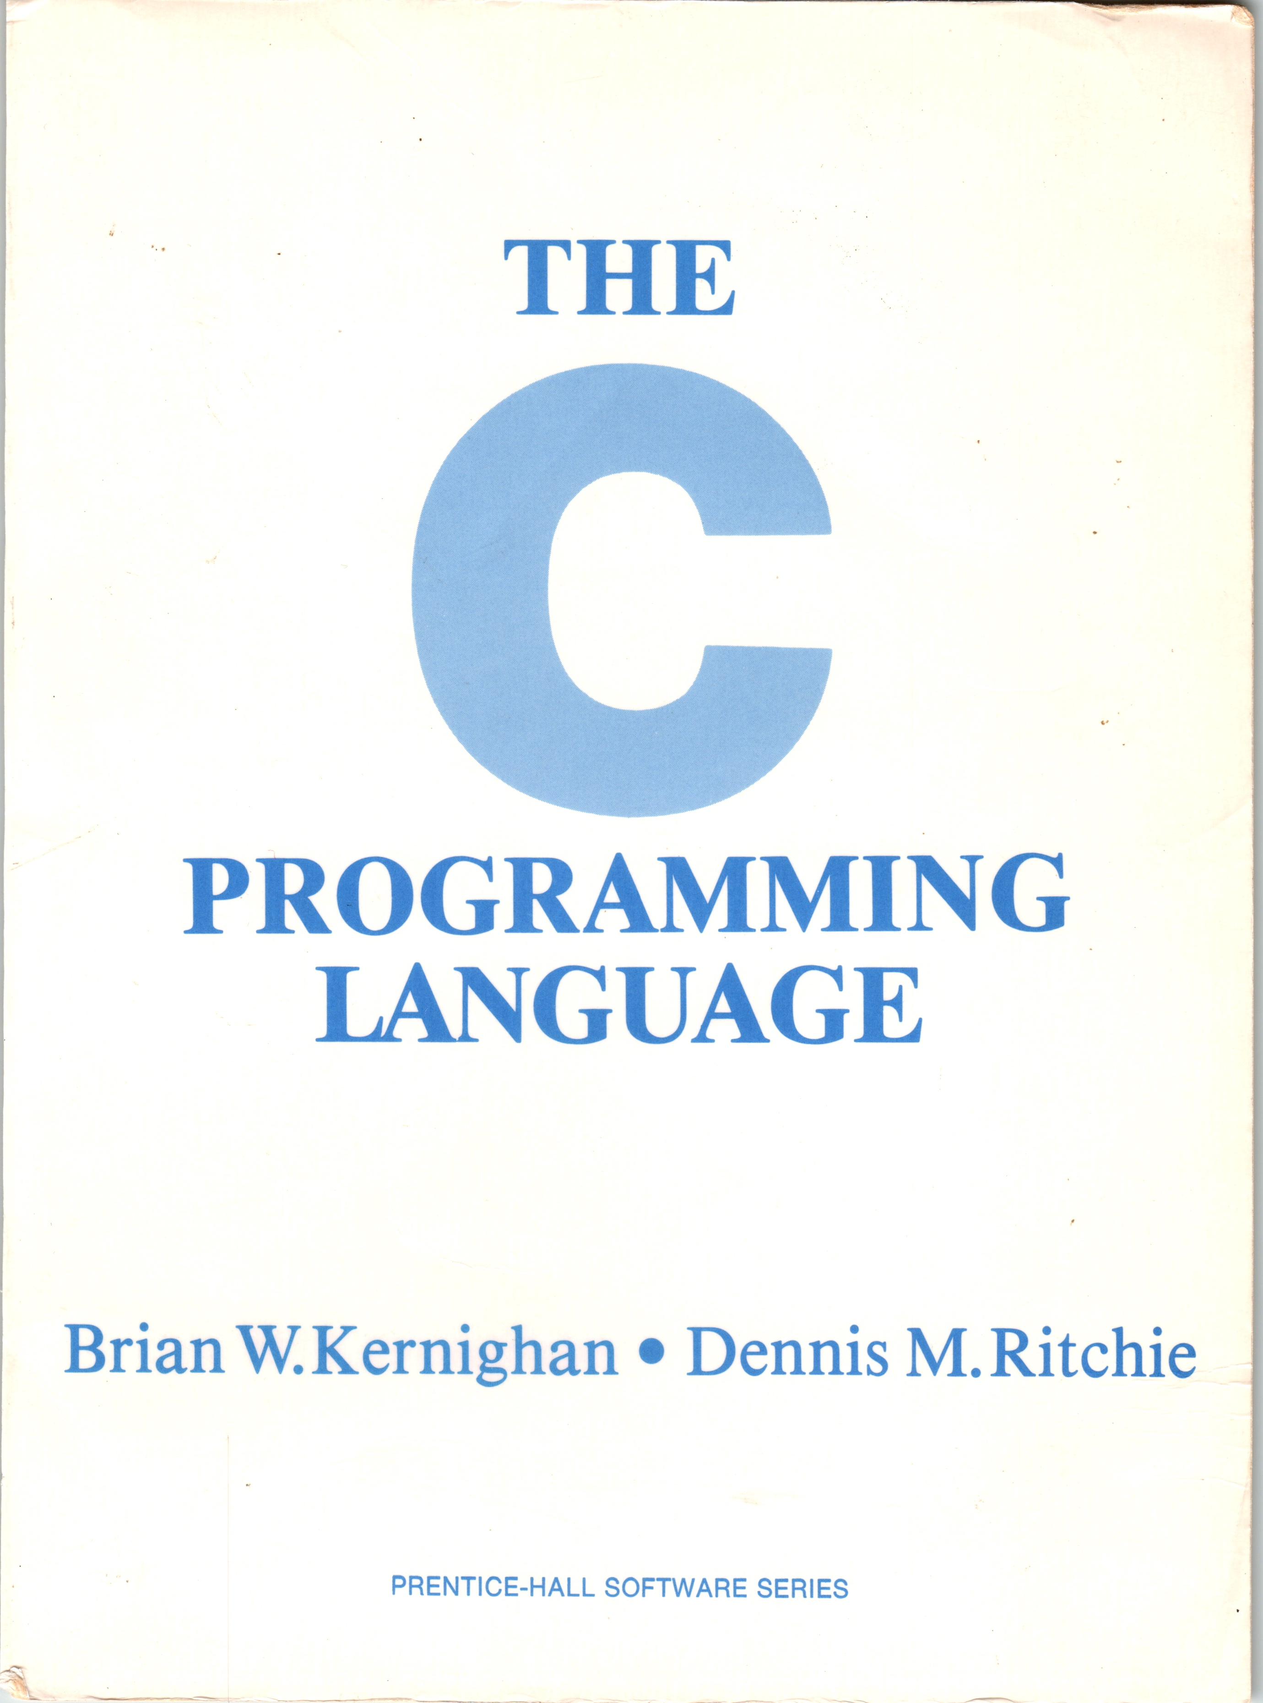

C Programming for Everybody
Uses 1978 edition of book to focus on historical context
Digitized online textbook with executable examples
Accessible audio book including code samples
Starts by comparing Python to C (Rosetta Stone)
Ends with building Python objects in C
This C course is about deeply understanding Python and OO
Extras
Interviews: Brian Kernighan, Bjarne Stroustrup, Guido van Rossum

Slide 11
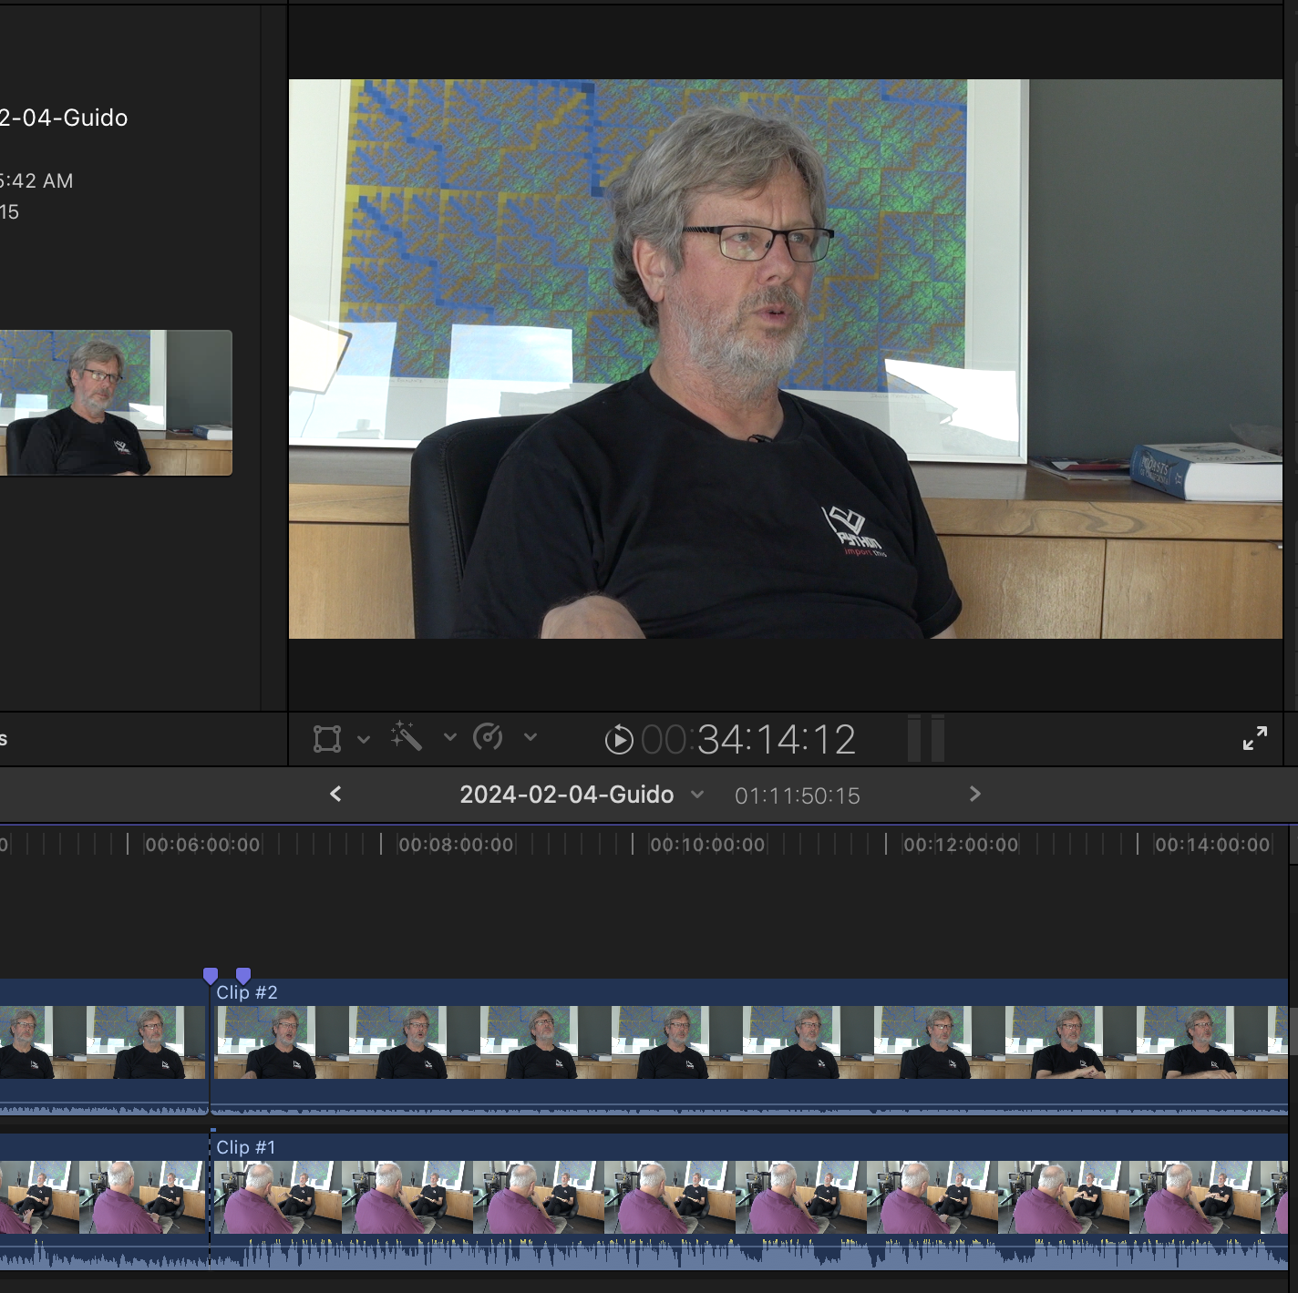
Epilogue
I interviewed Guido and asked if my implementations matched his implementation approach in Python 0.9
My implementations were not even close!
So I added an epilogue where I re-implement Python objects using the approach in Python 0.9 and Python 3.7

Slide 12
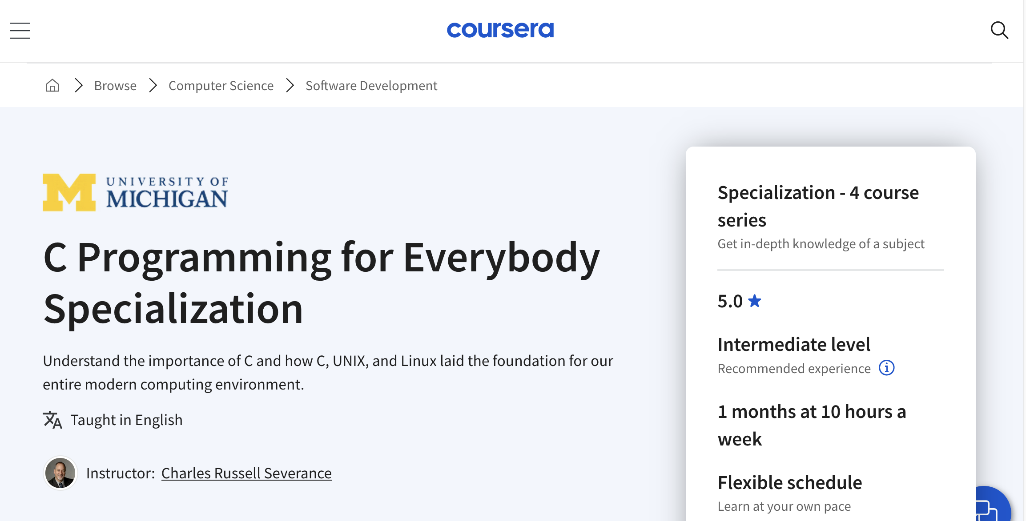

Slide 13
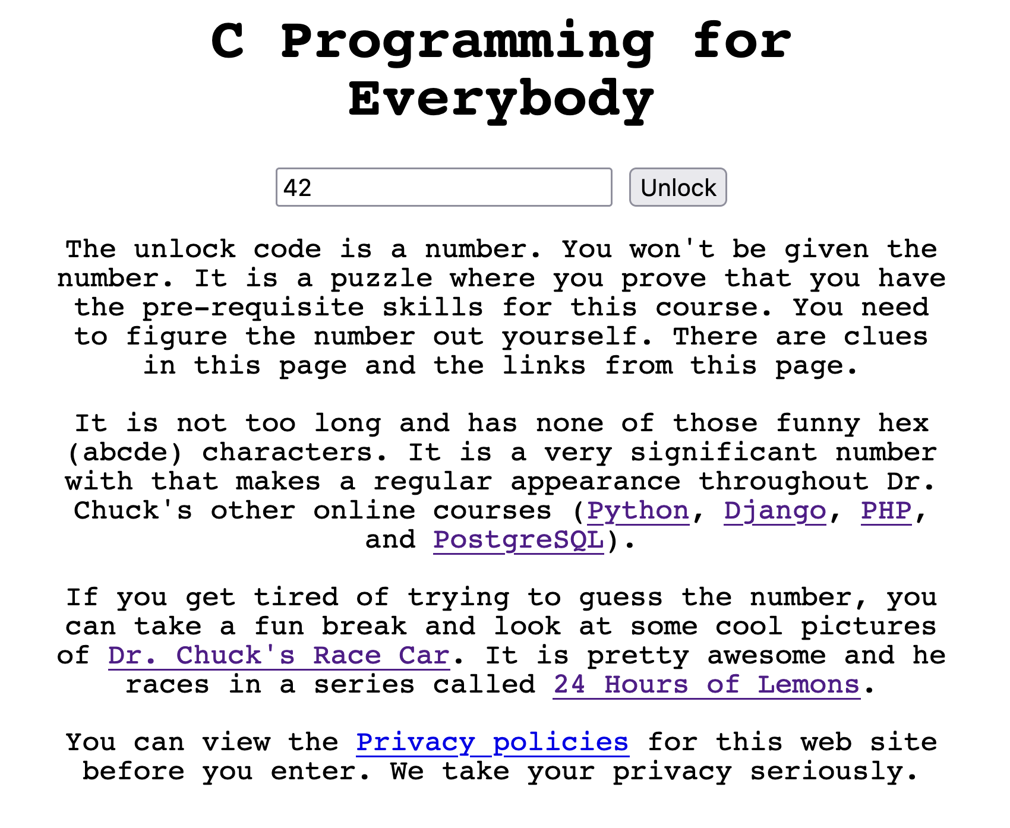

www.cc4e.com
It is 100% free, and all resources are CC or Apache. But I hid it behind a code to avoid legal trouble ☺

Slide 14
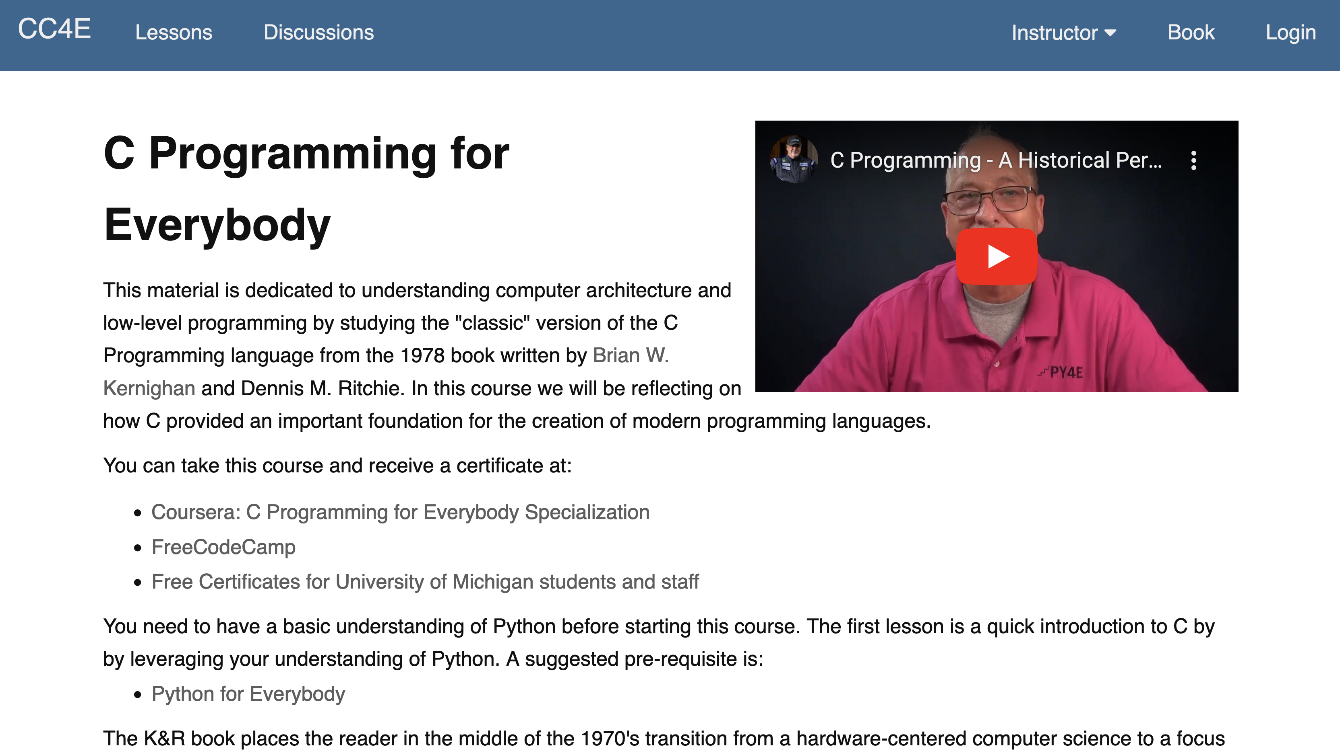

Slide 15
www.cc4e.com
C Programming for Everybody
Charles R. Severance (a.k.a Dr. Chuck)

